Slide 1

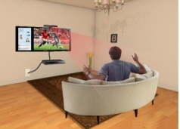
Research Institute for Future Media Computing
http://futuremedia.szu.edu.cn
未来媒体技术与计算研究所
Signal Processing
8. Image compression
Ling Liu
(Slides provided by Jari Korhonen)
Shenzhen University, School of Computer Science and Software Engineering
Office Room: 1030
Email: liulingcs@szu.edu.cn

Slide 2
Image compression
Typical stages in image compression (e.g. JPEG standard)
Color space conversion, block transform, quantization, coding
In decoding, same process repeated inversely

Slide 3
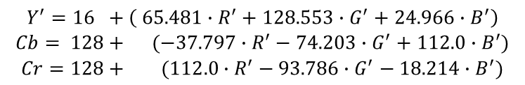
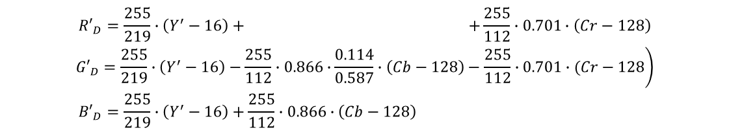
Y’CbCr (YUV) color model
In many practical applications (such as image compression), it is useful to convert RGB image to different color space, such as Y’CbCr
Brightness information carried in monochrome signal Y, and color information carried in two chrominance signals Cb and Cr
Conversion from R’G’B’ (normalized RGB) to Y’CbCr:
$$\begin{matrix}Y^{′}=16 +\left( 65.481∙R^{′}+128.553∙G^{′}+24.966∙B^{′}\right) \\ Cb= 128+ (−37.797∙R^{′}−74.203∙G^{′}+112.0∙B^{′}) \\ Cr=128+ (112.0∙R^{′}−93.786∙G^{′}−18.214∙B^{′})\end{matrix}$$
Conversion from Y’CbCr to R’G’B’:
$$\begin{matrix}{R′}_{D}=\frac{255}{219}∙\left(Y^{′}−16\right)+ +\frac{255}{112}∙0.701∙\left(Cr−128\right) \\ \left.{G′}_{D}=\frac{255}{219}∙\left(Y^{′}−16\right)−\frac{255}{112}∙0.866∙\frac{0.114}{0.587}∙\left(Cb−128\right)−\frac{255}{112}∙0.701∙(Cr−128\right) \\ {B′}_{D}=\frac{255}{219}∙\left(Y^{′}−16\right)+\frac{255}{112}∙0.866∙\left(Cb−128\right) \end{matrix}$$
Notes:
RGB YUV YCbCr

Slide 4
Y’CbCr conversion example
red
Y’
RGB to Y’CbCr
green
Cb
blue
Cr

Slide 5
Psychovisual redundancy
Since human visual system is more sensitive to light than colors, we can downsize Cb and Cr images to save bits
Some information is lost in the downsampling and upsampling process, but the difference is not visually essential
Most typical format is Y’CbCr 4:2:0
Cb
Cr
Y’
Notes:
4:2:0 间隔采样 Y 是 Cb或者Cr的两倍

Slide 6
Block transform
Images (Y’, Cb and Cr components) are divided in blocks (8x8 pixels in JPEG) and each block is transformed to frequency domain by some transform (usually 2-D Discrete Cosine Transform, DCT)

Slide 7
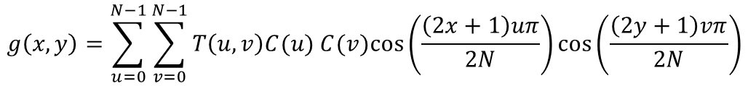
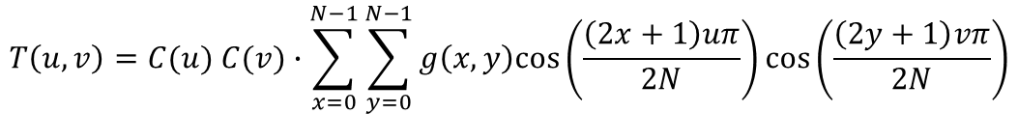
2-D Discrete Cosine Transform (DCT)
DCT as it is defined e.g. in JPEG standard:
where
Inverse transform similarly:
Can be implemented using FFT (fast computation)
Good energy compaction properties
$$T\left(u,v\right)=C(u) C(v)∙\sum_{x=0}^{N−1}{\sum_{y=0}^{N−1}{g\left(x,y\right)cos⁡\left(\frac{\left(2x+1\right)uπ}{2N}\right)cos⁡\left(\frac{\left(2y+1\right)vπ}{2N}\right)}}$$
$$g\left(x,y\right)=\sum_{u=0}^{N−1}{\sum_{v=0}^{N−1}{T\left(u,v\right)C(u) C(v)cos⁡\left(\frac{\left(2x+1\right)uπ}{2N}\right)cos⁡\left(\frac{\left(2y+1\right)vπ}{2N}\right)}}$$

Slide 8
Graphical illustration of DCT
In the output block, upper left corner represents DC component (block average), upper left side low frequency components and lower right side high frequency components
DC
low frequencies
high frequencies
2D DCT basis image

Slide 9
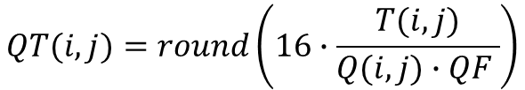
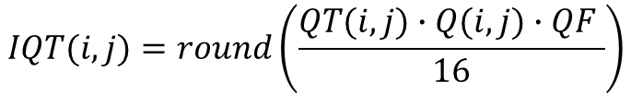
Quantization of DCT blocks
For the human visual system, the low frequencies are the most important
More accurate quantization for the upper left part of DCT block
In JPEG standard, the following quantization is used (for Y component):
Inverse quantization:
Quantization factor QF can be used to adjust compression level
8 16 19 22 26 27 29 34
16 16 22 24 27 29 34 37
19 22 26 27 29 34 34 38
22 22 26 27 29 34 37 40
22 26 27 29 32 35 40 48
26 27 29 32 35 40 48 58
26 27 29 34 38 46 56 69
27 29 35 38 46 56 69 83
$$QT(i,j)=round\left(16∙\frac{T(i,j)}{Q(i,j)∙QF }\right)$$
Q =
$$IQT(i,j)=round\left(\frac{QT(i,j)∙Q(i,j)∙QF }{16}\right)$$

Slide 10
Zic-zac scan
Pixels within a block tend to be correlated: high values usually clusterize in the upper left corner (low frequencies)
Zig-zag scan reads DCT coefficients in decreasing order of importance
The more important values (upper left) quantized with higher accuracy (smaller quantization steps)
After quantization, a lot of zeros in the bottom right; can be coded efficiently with run-length coding
Coefficients
Quantization
Lossless compression
178, 32, -8, 4, -16, 0, 2, ...
Zig-zag scan

Slide 11
Run-length coding
After quantization, coefficients need to be coded somehow
For the low frequency components, coefficients can be coded directly as symbols (e.g. Huffman/arithmetic coding)
For the high frequency components, we can use run-length coding: number of zeros coded together with coefficients
Run-length codes can be losslessly coded with e.g. Huffman codes
sequence
1
run-length codes

Slide 12
Summary
Typically four stages in image compression
Color space conversion (e.g. from RGB to Y’CbCr 4:2:0)
Block transform (typically DCT)
Quantization (can be adjusted to achieve target compression ratio)
Lossless coding (zic-zac scan, run-length coding, for final sequence of symbols e.g. Huffman coding)
More information: https://en.wikipedia.org/wiki/JPEG
In image decompression, the process is repeated inversely
Lossless decoding, inverse quantization, inverse DCT, conversion from Y’CbCr back to RGB

